Slide 1

EDUCATIONAL ORGANISATION USING SERVICENOW
Presented by Navya V & Supriya A
From Annamacharya Institute of Technology and sciences, Tirupati

Slide 2

Educational organization using ServiceNow

Slide 3
Agenda
Introduction to ServiceNow
ServiceNow in the Education Sector
Project overview
Implementation Strategy
Functional requirements
Advantages and disadvantages
Security, Compliance & Data Privacy
Guidelines
Processing steps
Result
Usecases

Slide 4
Introduction to ServiceNow
What is Serviceow?
ServiceNow is a cloud-based digital workflow platform that helps organizations automate and streamline their business processes—especially those related to IT services, HR, customer service, facilities, and more.
ServiceNow is like a central control system for handling requests, solving problems, and keeping operations running smoothly—without needing paper forms, endless emails, or manual tracking.

Slide 5
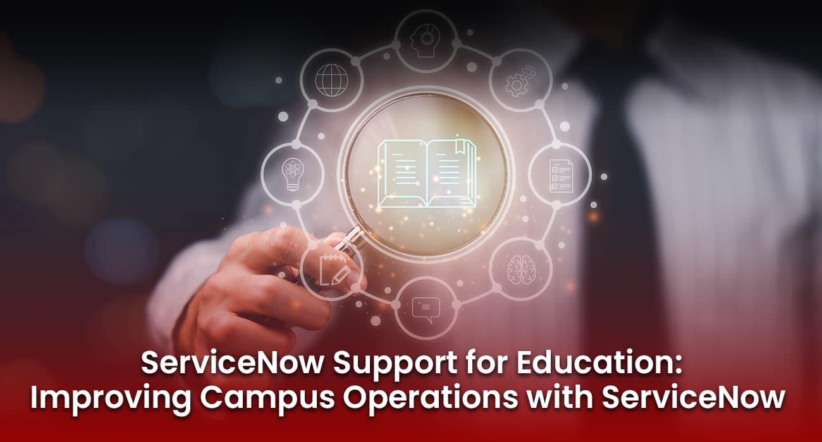
ServiceNow in the Education Sector

Slide 6
ServiceNow in the Education Sector
ServiceNow is transforming how educational institutions operate by digitizing and automating services across IT, HR, student support, and administration—creating seamless, efficient experiences for students, faculty, and staff.
Key factors of ServiceNow in the Education Sector
T Service Management (ITSM)
Student Services & Support
HR Service Delivery (HRSD)
Facilities and Operations Management

Slide 7
Project overview
This project aims to develop a comprehensive service management system tailored for an educational organization using ServiceNow. The platform centralizes requests and automates workflows related to IT s services, academic support, facility management, and student services. By leveraging ServiceNow’s powerful capabilities in workflow automation and IT service management, this system enhances the operational efficiency of educational institutions and provides a seamless experience for students, faculty, and administrators.

Slide 8
Implementation Strategy
Assessment & Planning
Process Mapping & Requirement Gathering
Platform Configuration
Integration with Existing Systems
Pilot & Testing
Training & Change Management
Full-Scale Deployment
Monitoring & Continuous Improvement

Slide 9
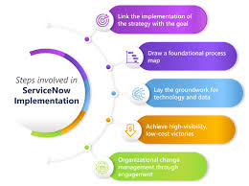
Steps for the Implementation of ServiceNow

Slide 10
Functional Requirements
User Management and Access Control
Role-based access for students, faculty, staff, and admin
Single sign-on (SSO) integration with campus authentication systems
IT Service Management (ITSM)
Incident, problem, and change management workflows
Automated ticket creation and routing
Asset and configuration management (CMDB) for devices and software
Self-Service Portals
Student and staff portals for submitting requests and incidents
Knowledge base with FAQs and tutorials
Mobile-friendly interface
HR Service Delivery (HRSD)
Automated onboarding and offboarding processes
Leave requests, payroll inquiries, benefits management
Case management for HR-related issues

Slide 11
Student Services Management
Case management for counseling, academic support, and financial aid
Appointment scheduling and tracking
Integration with Student Information Systems (SIS)
Facilities and Campus Services Management
Maintenance request submission and tracking
Asset and space management
Scheduling preventive maintenance tasks
Workflow Automation
Customizable workflows for approvals, notifications, and escalations
Integration with existing campus systems (ERP, LMS)
Low-code/no-code tools for building new apps
Reporting and Analytics
Dashboards for monitoring ticket volumes, service levels, and user satisfaction
Compliance and audit reporting
Usage statistics for continuous improvement

Slide 12
Advantages Disadvantages
High Implementation and Licensing Cost
Complex Configuration and Setup
Change Management Challenges
Training Requirements
Overhead for Maintenance
Underutilization Risk
Centralized Service Management
Automation of Manual Processes
Improved User Experience
Better Transparency and Accountability
Data-Driven Decision Making
Compliance and Security
Scalability
Integration Capabilities

Slide 13
Security, Compliance & Data Privacy
Data encryption and secure data storage
FERPA and GDPR compliance features
Audit trails and access logs
Data Privacy Management
Tools to manage consent and data access requests in compliance with privacy laws
Automated data anonymization or masking for reporting and testing environments

Slide 14
Guidelines to follow in ServiceNow
Firstly create an instance in the ServiceNow
Then after make sure the administrator is connected through the account
Create the tables in the serviceNow main page which are necessary for the student admin communication
Build the fields which are needed carefully and assign the type of field and size of field
Build the layout form , the layout form is nothing but the fields that are to be displayed on the screen
As same as the layout form ,build the design form ,it says what should be displayed on the screen
Its time to write the client scripts in the ServiceNow webpage through the scripts it gives the progess of the student with the admin number
After successfully completion of the scripts then once check the result.

Slide 15
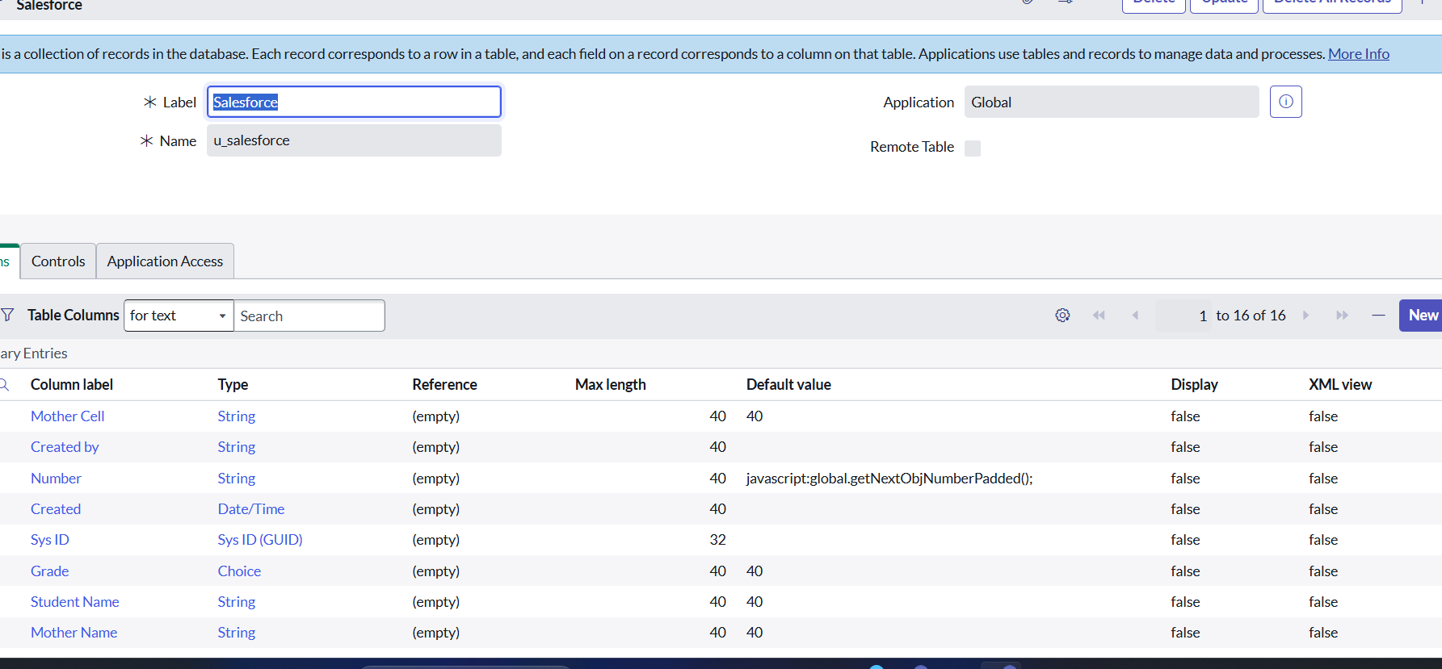
Create the tables as below:

Slide 16
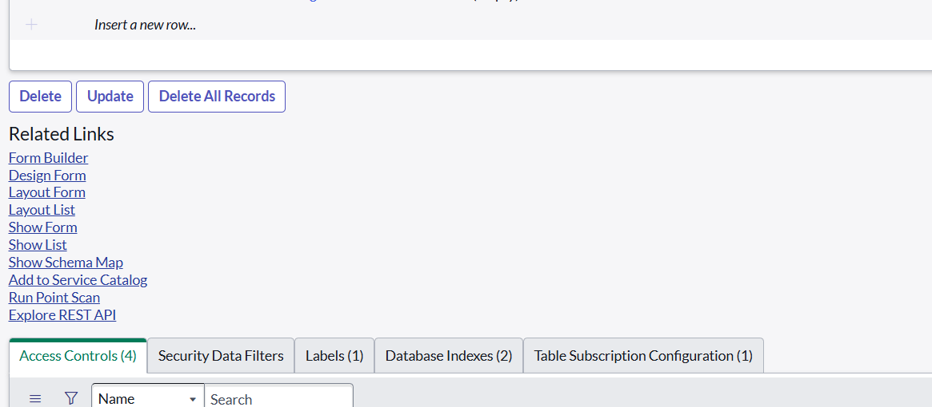
Build the layouts and Designs :

Slide 17
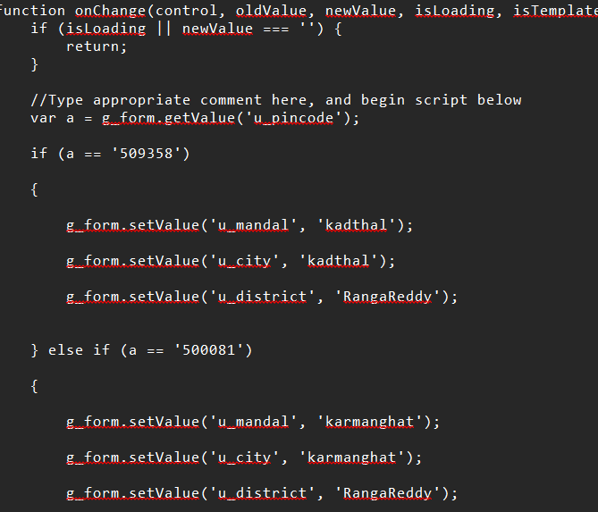
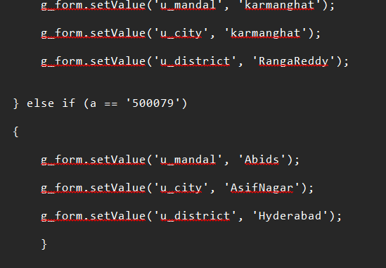
Here few images of Clientscripts are provided below
Write the client scripts for the necessary features in the educational organization

Slide 18
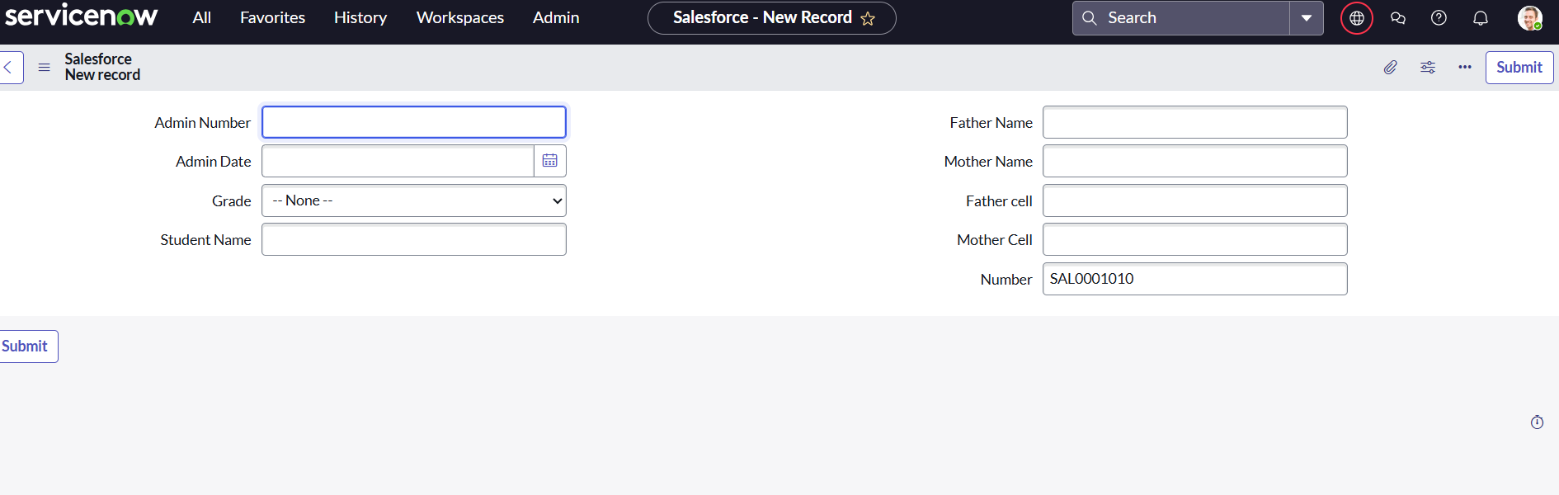
Result of the Project

Slide 19
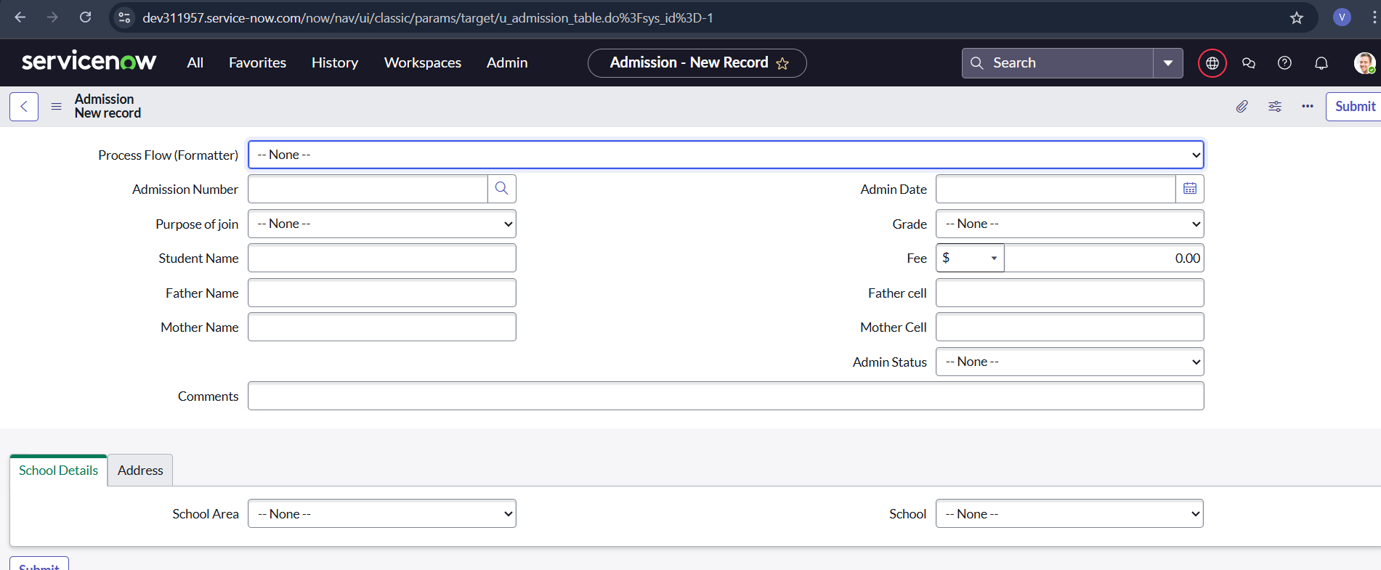
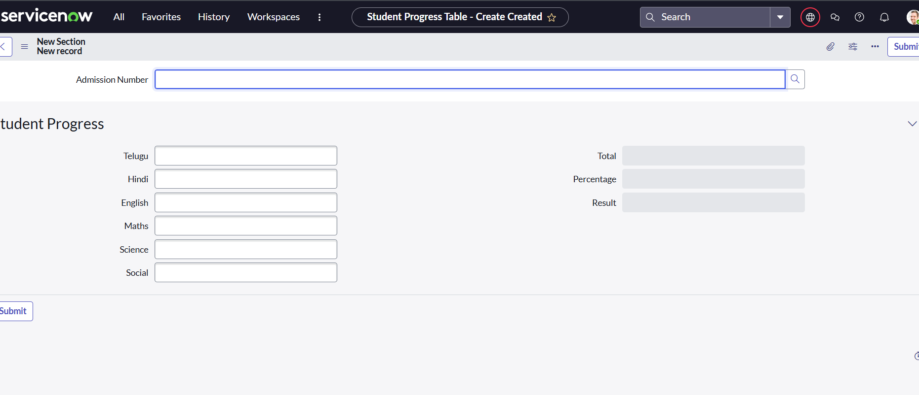
Result

Slide 20
Use cases
IT Help Desk and Technical Support
Faculty and Staff Onboarding
Facilities and Maintenance Requests
Student Services and Case Management
Digitization of Administrative Processes
Knowledge Base & Self-Service Portal
Security and Compliance Management

Slide 21
Thank
You
A Project by Navya v & Supriya A
Thanks for watching!Please Share Your Feedback on Our Project
GitHub:https://github.com/Navya547-vemula/Educational-organisation-using-ServiceNow-/settings/access?guidance_task=

